Slide 1

Programming Languages
Third Edition
Chapter 6
Syntax

Slide 2
Objectives
Understand the lexical structure of programming languages
Understand context-free grammars and BNFs
Become familiar with parse trees and abstract syntax trees
Understand ambiguity, associativity, and precedence
Learn to use EBNFs and syntax diagrams
Programming Languages, Third Edition

Slide 3
Objectives (cont’d.)
Become familiar with parsing techniques and tools
Understand lexics vs. syntax vs. semantics
Build a syntax analyzer for TinyAda
Programming Languages, Third Edition

Slide 4
Introduction
Syntax is the structure of a language
1950: Noam Chomsky developed the idea of context-free grammars
John Backus and Peter Naur developed a notational system for describing these grammars, now called Backus-Naur forms, or BNFs
  First used to describe the syntax of Algol60
Every modern computer scientist needs to know how to read, interpret, and apply BNF descriptions of language syntax
Programming Languages, Third Edition

Slide 5
Introduction (cont’d.)
Three variations of BNF:
  Original BNF
  Extended BNF (EBNF)
  Syntax diagrams
Programming Languages, Third Edition

Slide 6
Lexical Structure of Programming Languages
Lexical structure: the structure of the tokens, or words, of a language
  Related to, but different than, the syntactic structure
Scanning phase: the phase in which a translator collects sequences of characters from the input program and forms them into tokens
Parsing phase: the phase in which the translator processes the tokens, determining the program’s syntactic structure
Programming Languages, Third Edition

Slide 7
Lexical Structure of Programming Languages (cont’d.)
Tokens generally fall into several categories:
  Reserved words (or keywords)
  Literals or constants
  Special symbols, such as “;”m “<=“, or “+”
  Identifiers
Predefined identifiers: identifiers that have been given an initial meaning for all programs in the language but are capable of redirection
Principle of longest substring: process of collecting the longest possible string of nonblank characters
Programming Languages, Third Edition

Slide 8
Lexical Structure of Programming Languages (cont’d.)
Token delimiters (or white space): formatting that affects the way tokens are recognized
Indentation can be used to determine structure
Free-format language: one in which format has no effect on program structure other than satisfying the principle of longest substring
Fixed format language: one in which all tokens must occur in prespecified locations on the page
Tokens can be formally described by regular expressions
Programming Languages, Third Edition

Slide 9
Lexical Structure of Programming Languages (cont’d.)
Three basic patterns of characters in regular expressions:
  Concatenation: done by sequencing the items
  Repetition: indicated by an asterisk after the item to be repeated
  Choice, or selection: indicated by a vertical bar between items to be selected
[ ] with a hyphen indicate a range of characters
? indicates an optional item
Period indicates any character
Programming Languages, Third Edition

Slide 10
Lexical Structure of Programming Languages (cont’d.)
Examples:
  Integer constants of one or more digits
  Unsigned floating-point literals
Most modern text editors use regular expressions in text searches
Utilities such as lex can automatically turn a regular expression description of a language’s tokens into a scanner
Programming Languages, Third Edition

Slide 11
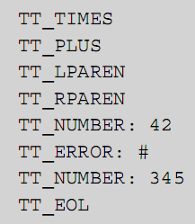
Lexical Structure of Programming Languages (cont’d.)
Simple scanner input:
Produces this output:
Programming Languages, Third Edition

Slide 12
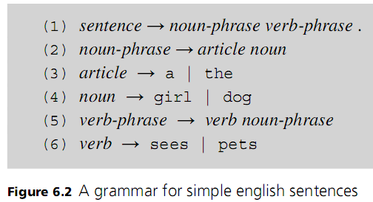
Context-Free Grammars and BNFs
Example: simple grammar
→ separates left and right sides
| indicates a choice
Programming Languages, Third Edition

Slide 13
Context-Free Grammars and BNFs (cont’d.)
Metasymbols: symbols used to describe the grammar rules
Some notations use angle brackets and pure text metasymbols
  Example:
Derivation: the process of building in a language by beginning with the start symbol and replacing left-hand sides by choices of right-hand sides in the rules
Programming Languages, Third Edition

Slide 14
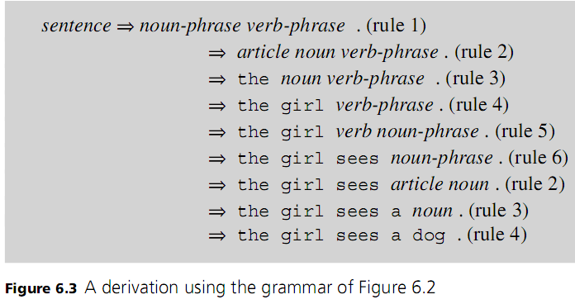
Context-Free Grammars and BNFs (cont’d.)
Programming Languages, Third Edition

Slide 15
Context-Free Grammars and BNFs (cont’d.)
Some problems with this simple grammar:
  A legal sentence does not necessarily make sense
  Positional properties (such as capitalization at the beginning of the sentence) are not represented
  Grammar does not specify whether spaces are needed
  Grammar does not specify input format or termination symbol
Programming Languages, Third Edition

Slide 16
Context-Free Grammars and BNFs (cont’d.)
Context-free grammar: consists of a series of grammar rules
Each rule has a single phrase structure name on the left, then a → metasymbol, followed by a sequence of symbols or other phrase structure names on the right
Nonterminals: names for phrase structures, since they are broken down into further phrase structures
Terminals: words or token symbols that cannot be broken down further
Programming Languages, Third Edition

Slide 17
Context-Free Grammars and BNFs (cont’d.)
Productions: another name for grammar rules
  Typically there are as many productions in a context-free grammar as there are nonterminals
Backus-Naur form: uses only the metasymbols “→” and “|”
Start symbol: a nonterminal representing the entire top-level phrase being defined
Language of the grammar: defined by a context-free grammar
Programming Languages, Third Edition

Slide 18
Context-Free Grammars and BNFs (cont’d.)
A grammar is context-free when nonterminals appear singly on the left sides of productions
  There is no context under which only certain replacements can occur
Anything not expressible using context-free grammars is a semantic, not a syntactic, issue
BNF form of language syntax makes it easier to write translators
Parsing stage can be automated
Programming Languages, Third Edition

Slide 19
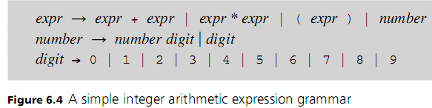
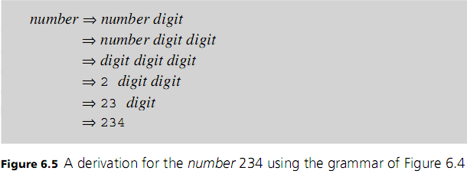
Context-Free Grammars and BNFs (cont’d.)
Rules can express recursion
Programming Languages, Third Edition

Slide 20
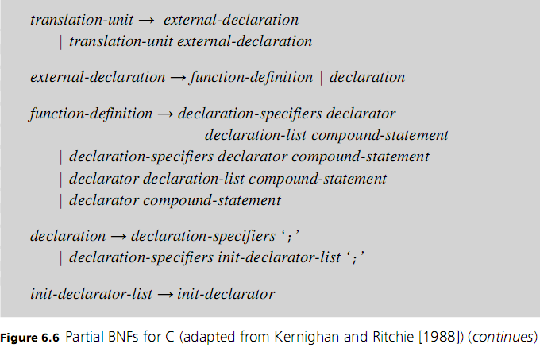
Context-Free Grammars and BNFs (cont’d.)
Programming Languages, Third Edition

Slide 21
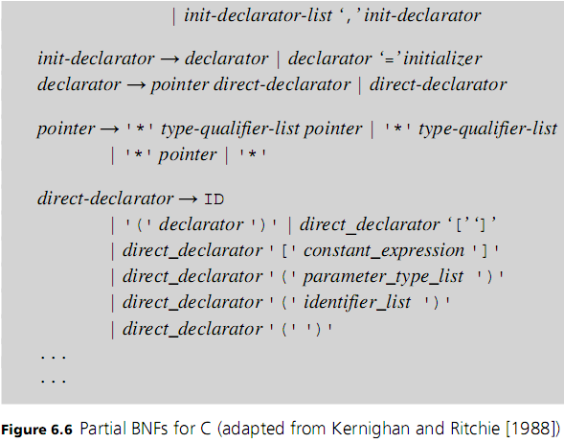
Context-Free Grammars and BNFs (cont’d.)
Programming Languages, Third Edition

Slide 22
Parse Trees and Abstract Syntax Trees
Syntax establishes structure, not meaning
  But meaning is related to syntax
Syntax-directed semantics: process of associating the semantics of a construct to its syntactic structure
  Must construct the syntax so that it reflects the semantics to be attached later
Parse tree: graphical depiction of the replacement process in a derivation
Programming Languages, Third Edition

Slide 23
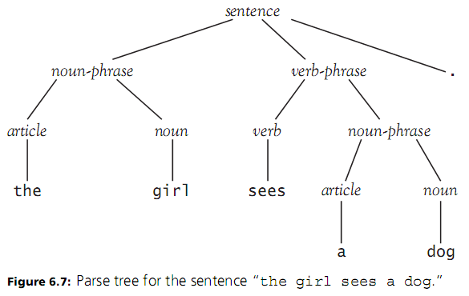
Parse Trees and Abstract Syntax Trees (cont’d.)
Programming Languages, Third Edition

Slide 24
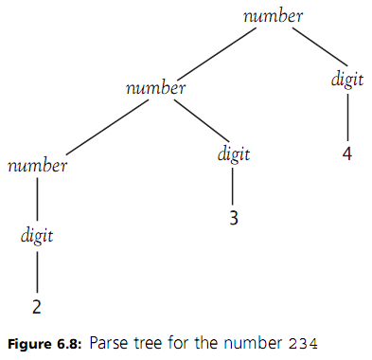
Parse Trees and Abstract Syntax Trees (cont’d.)
Programming Languages, Third Edition

Slide 25
Parse Trees and Abstract Syntax Trees (cont’d.)
Nodes that have at least one child are labeled with nonterminals
Leaves (nodes with no children) are labeled with terminals
The structure of a parse tree is completely specified by the grammar rules of the language and a derivation of the sequence of terminals
All terminals and nonterminals in a derivation are included in the parse tree
Programming Languages, Third Edition

Slide 26
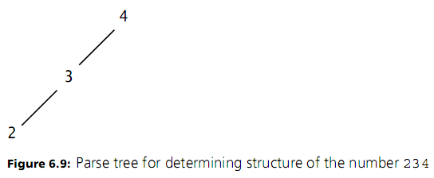
Parse Trees and Abstract Syntax Trees (cont’d.)
  Not all terminals and nonterminals are needed to determine completely the syntactic structure of an expression or sentence
Programming Languages, Third Edition

Slide 27
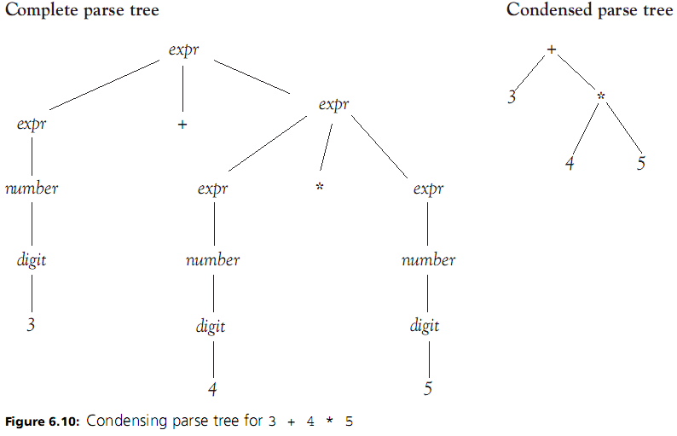
Programming Languages, Third Edition

Slide 28
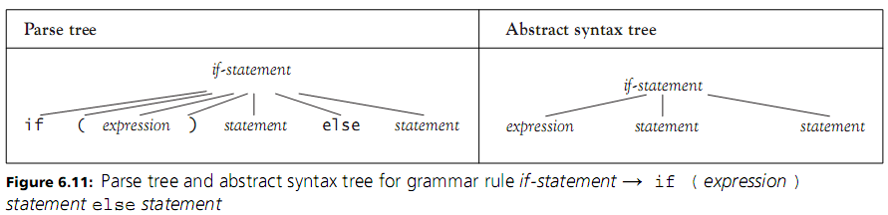
Parse Trees and Abstract Syntax Trees (cont’d.)
Abstract syntax trees (or syntax trees): trees that abstract the essential structure of the parse tree
  Do away with terminals that are redundant
Example:
Programming Languages, Third Edition

Slide 29
Parse Trees and Abstract Syntax Trees (cont’d.)
Can write out rules for abstract syntax similar to BNF rules, but they are of less interest to a programmer
Abstract syntax is important to a language designer and translator writer
Concrete syntax: ordinary syntax
Programming Languages, Third Edition

Slide 30
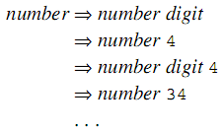
Ambiguity, Associativity, and Precedence
Two different derivations can lead to the same parse tree or to different parse trees
Ambiguous grammar: one for which two distinct parse or syntax trees are possible
Example: derivation for 234 given earlier
Programming Languages, Third Edition

Slide 31
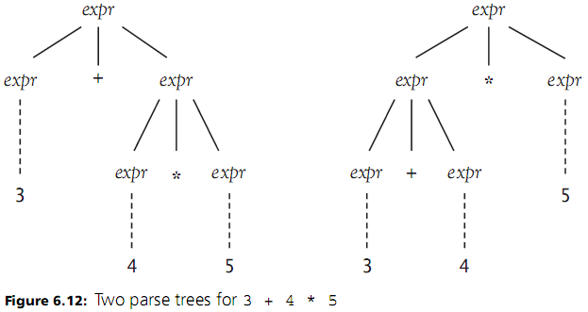
Ambiguity, Associativity, and Precedence (cont’d.)
Programming Languages, Third Edition

Slide 32
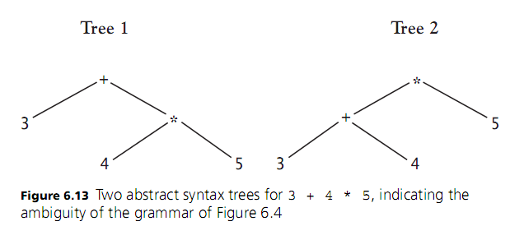
Ambiguity, Associativity, and Precedence (cont’d.)
Programming Languages, Third Edition

Slide 33
Ambiguity, Associativity, and Precedence (cont’d.)
Certain special derivations that are constructed in a special order can only correspond to unique parse trees
Leftmost derivation: the leftmost remaining nonterminal is singled out for replacement at each step
  Each parse tree has a unique leftmost derivation
Ambiguity of a grammar can be tested by searching for two different leftmost derivations
Programming Languages, Third Edition

Slide 34
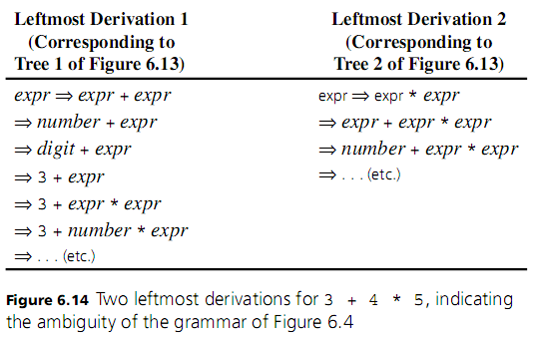
Ambiguity, Associativity, and Precedence (cont’d.)
Programming Languages, Third Edition

Slide 35
Ambiguity, Associativity, and Precedence (cont’d.)
Ambiguous grammars present difficulties
  Must either revise them to remove ambiguity or state a disambiguating rule
Usual way to revise the grammar is to write a new grammar rule called a term that establishes a precedence cascade
Can replace
  With either or
First rule is left-recursive; second rule is right-recursive
Programming Languages, Third Edition

Slide 36
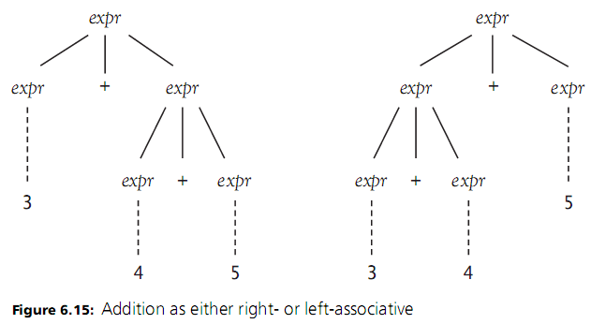
Ambiguity, Associativity, and Precedence (cont’d.)
Programming Languages, Third Edition

Slide 37
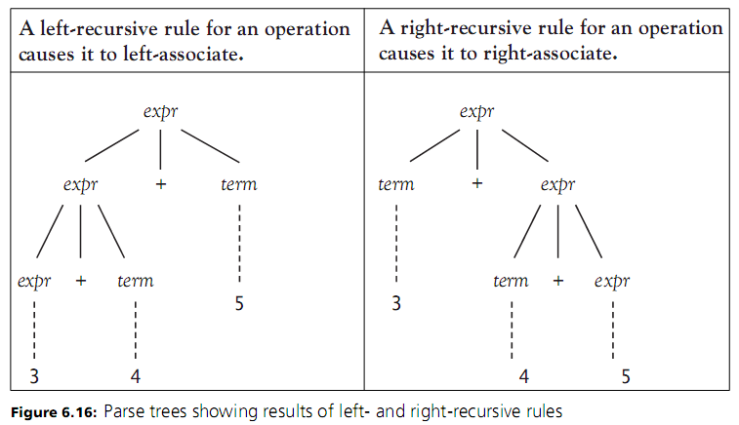
Ambiguity, Associativity, and Precedence (cont’d.)
Programming Languages, Third Edition

Slide 38
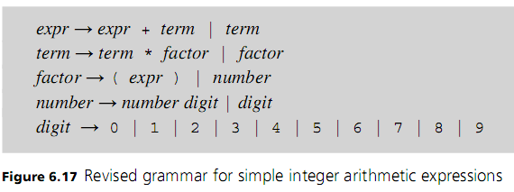
Ambiguity, Associativity, and Precedence (cont’d.)
Programming Languages, Third Edition

Slide 39

EBNFs and Syntax Diagrams
Extended Backus-Naur form (or EBNF): introduces new notation to handle common issues
Use curly braces to indicate 0 or more repetitions
  Assumes that any operator involved in a curly bracket repetition is left-associative
  Example:
Use square brackets to indicate optional parts
  Example:
Programming Languages, Third Edition

Slide 40
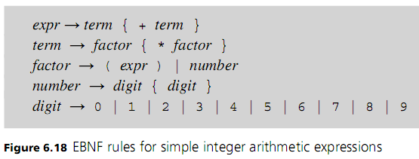
EBNFs and Syntax Diagrams (cont’d.)
Programming Languages, Third Edition

Slide 41
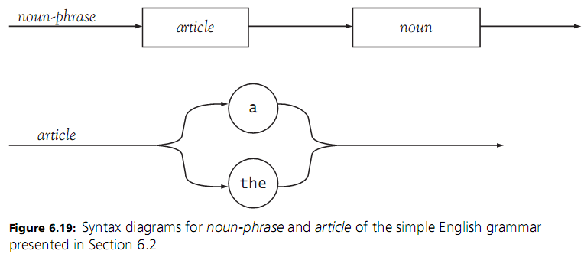
EBNFs and Syntax Diagrams (cont’d.)
Syntax diagram: indicates the sequence of terminals and nonterminals encountered in the right-hand side of the rule
Programming Languages, Third Edition

Slide 42
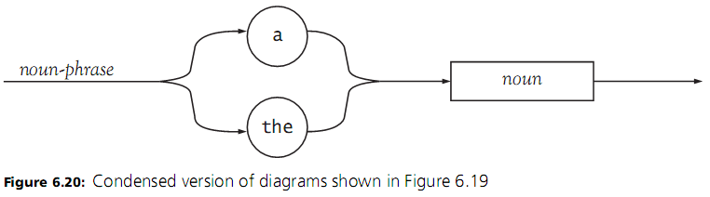
EBNFs and Syntax Diagrams (cont’d.)
Use circles or ovals for terminals, and squares or rectangles for nonterminals
  Connect them with lines and arrows indicating appropriate sequencing
Can condense several rules into one diagram
Use loops to indicate repetition
Programming Languages, Third Edition

Slide 43


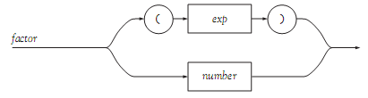

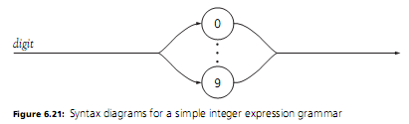
Programming Languages, Third Edition

Slide 44
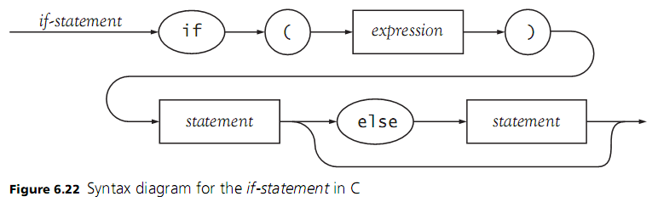
EBNFs and Syntax Diagrams (cont’d.)
Programming Languages, Third Edition

Slide 45
Parsing Techniques and Tools
A grammar written in BNF, EBNF, or syntax diagrams describes the strings of tokens that are syntactically legal
  It also describes how a parser must act to parse correctly
Recognizer: accepts or rejects strings based on whether they are legal strings in the language
Bottom-up parser: constructs derivations and parse trees from the leaves to the roots
  Matches an input with right side of a rule and reduces it to the nonterminal on the left
Programming Languages, Third Edition

Slide 46
Parsing Techniques and Tools (cont’d.)
Bottom-up parsers are also called shift-reduce parsers
  They shift tokens onto a stack prior to reducing strings to nonterminals
Top-down parser: expands nonterminals to match incoming tokens and directly construct a derivation
Parser generator: a program that automates top-down or bottom-up parsing
Bottom-up parsing is the preferred method for parser generators (also called compiler compilers)
Programming Languages, Third Edition

Slide 47
Parsing Techniques and Tools (cont’d.)
Recursive-descent parsing: turns nonterminals into a group of mutually recursive procedures based on the right-hand sides of the BNFs
  Tokens are matched directly with input tokens as constructed by a scanner
  Nonterminals are interpreted as calls to the procedures corresponding to the nonterminals
Programming Languages, Third Edition

Slide 48
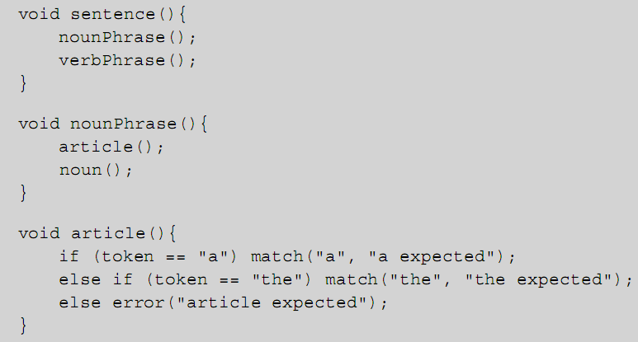
Parsing Techniques and Tools (cont’d.)
Programming Languages, Third Edition

Slide 49
Parsing Techniques and Tools (cont’d.)
Left-recursive rules may present problems
  Example:
  May cause an infinite recursive loop
  No way to decide which of the two choices to take until a + is seen
The EBNF description expresses the recursion as a loop:
Thus, curly brackets in EBNF represent left recursion removal by the use of a loop
Programming Languages, Third Edition

Slide 50

Parsing Techniques and Tools (cont’d.)
Code for a right-recursive rule such as:
This corresponds to the use of square brackets in EBNF:
  This process is called left-factoring
In both left-recursive and left-factoring situations, EBNF rules or syntax diagrams correspond naturally to the code of a recursive-descent parser
Programming Languages, Third Edition

Slide 51
Parsing Techniques and Tools (cont’d.)
Single-symbol lookahead: using a single token to direct a parse
Predictive parser: a parser that commits itself to a particular action based only on the lookahead
Grammar must satisfy certain conditions to make this decision-making process work
  Parser must be able to distinguish between choices in a rule
  For an optional part, no token beginning the optional part can also come after the optional part
Programming Languages, Third Edition

Slide 52
Parsing Techniques and Tools (cont’d.)
YACC: a widely used parser generator
  Freeware version is called Bison
  Generates a C program that uses a bottom-up algorithm to parse the grammar
YACC generates a procedure yyparse from the grammar, which must be called from a main procedure
YACC assumes that tokens are recognized by a scanner procedure called yylex, which must be provided
Programming Languages, Third Edition

Slide 53
Lexics vs. Syntax vs. Semantics
Specific details of formatting, such as white-space conventions, are left to the scanner
  Need to be stated as lexical conventions separate from the grammar
Also desirable to allow a scanner to recognize structures such as literals, constants, and identifiers
  Faster and simpler and reduces the size of the parser
Must rewrite the grammar to express the use of a token rather than a nonterminal representation
Programming Languages, Third Edition

Slide 54
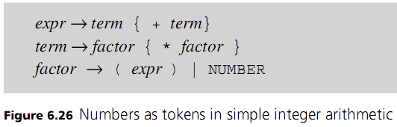
Lexics vs. Syntax vs. Semantics (cont’d.)
Example: a number should be a token
  Uppercase indicates it is a token whose structure is determined by the scanner
Lexics: the lexical structure of a programming language
Programming Languages, Third Edition

Slide 55
Lexics vs. Syntax vs. Semantics (cont’d.)
Some rules are context-sensitive and cannot be written as context-free rules
Examples:
  Declaration before use for variables
  No redeclaration of identifiers within a procedure
These are semantic properties of a language
Another conflict occurs between predefined identifiers and reserved words
  Reserved words cannot be used as identifiers
  Predefined identifiers can be redefined in a program
Programming Languages, Third Edition

Slide 56
Lexics vs. Syntax vs. Semantics (cont’d.)
Syntax and semantics can become interdependent when semantic information is required to distinguish ambiguous parsing situations
Programming Languages, Third Edition

Slide 57
Case Study: Building a Syntax Analyzer for TinyAda
TinyAda: a small language that illustrates the syntactic features of many high-level languages
TinyAda includes several kinds of declarations, statements, and expressions
Rules for declarations, statements, and expressions are indirectly recursive, allowed for nested declarations, statements, and expressions
Parsing shell: applies the grammar rules to check whether tokens are of the correct types
  Later, we will add mechanisms for semantic analysis
Programming Languages, Third Edition

Slide 58
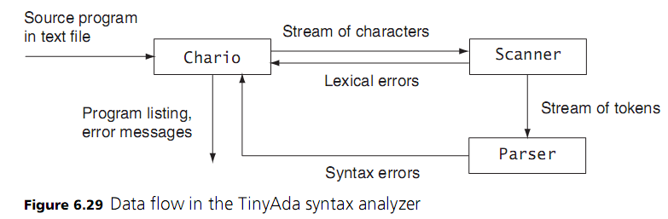
Case Study: Building a Syntax Analyzer for TinyAda (cont’d.)
Programming Languages, Third Edition

